Slide 1
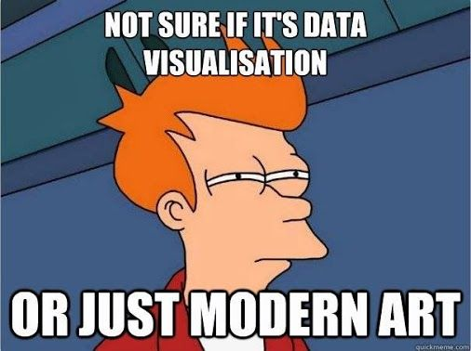
Source

Slide 2
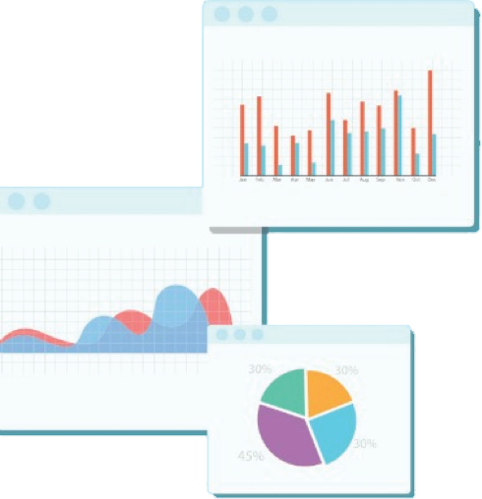

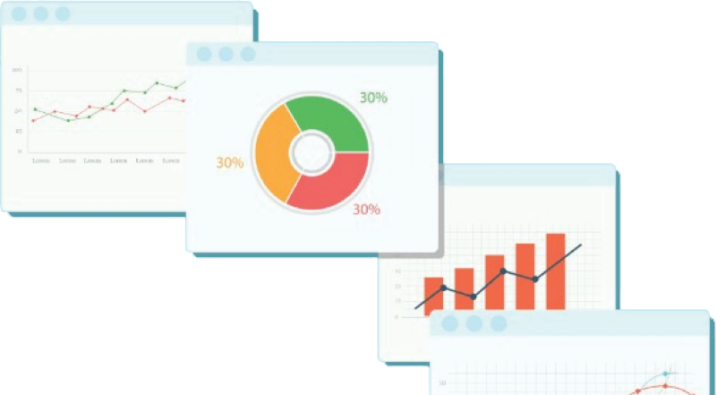
Welcome to Week 3
Lecture 2!
Data Science in Python &
Machine Learning

Slide 3
Week 3 CORE Assignments
These must be submitted by Sunday February 13th:
Belt exam takes priority, though!!!
Average Height Exercise (Core)
Histograms & Boxplots (Core)
Project 1 - Part 3 (Core)

Slide 4
🥋Stack 1 Belt Exam Eligibility🥋
Belt exam is this weekend!
Eligibility:
90 % of Week 1 & 2 Assignments (Including resubmits)
No more than 1 missing/pending resubmissions
Due: 9 AM PST on Thursday (02/10/22)
80% attendance (no more than 1 missed lecture)
Unlock Codes:
Sent via email after class tonight
Note: once unlocked, you have up to 24 hours to complete exam
You may wait until Sunday morning to start exam
but need to submit it by 11:59 PM Sunday (so <24 hours)

Slide 5
Belt Exam Rules and Policies
You can unlock the exam any time after you receive the unlock code provided in your email. Once you unlock the exam, you will have 24 hours to submit your work. So make sure not to unlock the exam until you are ready to start working.
Recommend doing at least 2 of Week 3’s assignments BEFORE unlocking exam!
The belt exam must be submitted by end of day Sunday on 02/13/21.
You may use any materials on the exam (notes, classwork, Google, Stackoverflow, etc.) BUT YOU MUST CITE YOUR SOURCES!!! Include a comment or a text cell with a link to any sources used.
Example:
“# Code adapted from: https://stackoverflow.com/questions/19966018/pandas-filling-missing-values-by-mean-in-each-group”
You must complete the belt exam entirely on your own.
You may NOT work with anyone else on this exam. Any collaboration is cause for expulsion.
Do NOT post anything related to the belt exam on Github or anywhere on the internet. This will be interpreted as collaboration and is cause for expulsion.

Slide 6
Belt Exam Rules and Policies
I will check email on Friday in case you have issues on the platform (not content or coding questions). I will NOT check Discord. (jirving@codingdojo.com)
NOTE: NO exam codes will be sent from Friday 02/11/22 through Sunday 02/13/22.
You can contact a TA through direct message on Discord if you have process questions! (TAs can help with your week 3 assignments, just not the belt exam)
Do NOT contact any other students regarding the belt exam, even if they are questions about instructions or policies.
Do NOT post questions or comments about the belt exam in our Discord Channel
If something goes wrong on the platform when trying to submit, don’t stress, just email me your completed materials as a backup within the 24 hour time period ( jirving@codingdojo.com ).

Slide 7
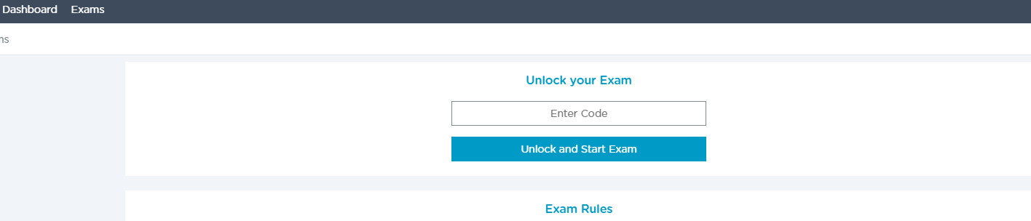
Accessing the Belt Exam:
To take your Belt exam, go to https://login.codingdojo.com/exams.
Enter in your code:(To be emailed to you)
Then select “Unlock and Start Exam.”

Slide 8
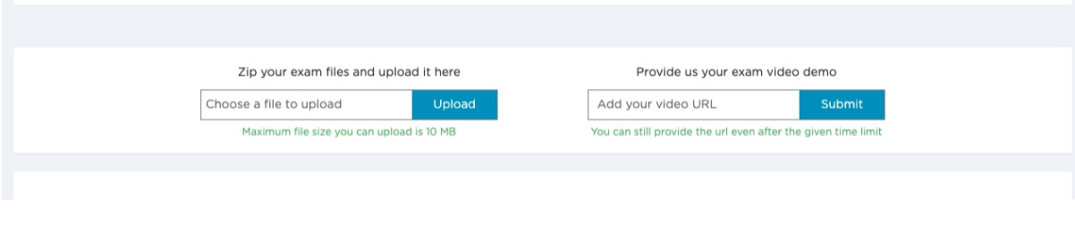
Belt Exam:
Your first belt exam consists of one part:
1) Submitting your commented code file
Optional Starter Notebook with Checklist rubric!
In our notes repo (https://github.com/sensei-jirving/Online-DS-PT-01.24.22-cohort-notes)
StarterNotebooks folder > Belt_Exam_1_Starter_Notebook_01-24-22.ipynb
No video!

Slide 9
Please be aware that every data set and problem is different.
The sample solutions for this mock belt exam cannot be applied in the same way to other data sets/problems.
Attempting to copy/paste this code or any other code into your belt exam without understanding what you are doing and why you are doing it will lead to bad outcomes!

Slide 10
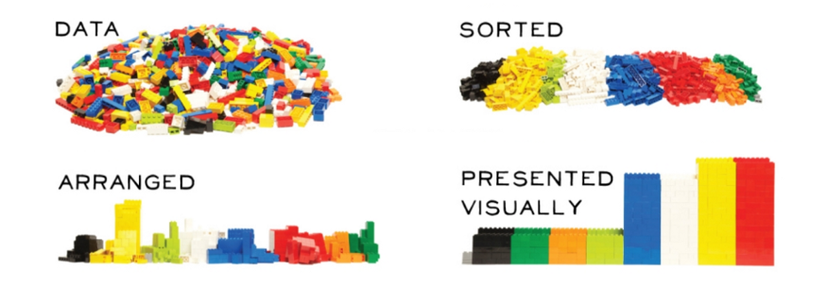
Exploratory Data Analysis:
Understanding your Data
Source

Slide 11
Overview of The EDA Process (Suggestion)
Initial Exploration: Get a feel for your data set
What are the columns?
What is the type of data for each column
How much data do you have?
Are you missing data points?
Clean: Prepare the data for analysis
Make sure you have the appropriate data type (are numerical values actually numerical data types?)
Make sure your categorical data is consistent
Address missing values
Address any other obvious errors in your data (Example: Age can’t be 230!)
Univariate Visuals: Explore the distribution of each column of data
Histograms and boxplots
Bar charts
Multivariate Visuals: Explore relationships between variables and differences in groups
Scatterplots
Correlation Heatmaps
Multivariable bar charts or boxplots
Go back and repeat any step as needed

Slide 12
Learning Goals
By the end of this lesson you will be able to:
Multivariate Data Visualizations
Interpret Correlation Plots
Identify Correlations with Scatter Plots
Create a Three Variable Plot using Seaborn

Slide 13
Warm up:
Why would we do univariate exploratory analysis on our data?

Slide 14
Multivariate Analysis
Exploring multiple variables at the same time
We mostly look at just two variables which is also known as bivariate analysis
Consider relationships or patterns

Slide 15
Correlation: Related Variables
When two or more variables tend to change together:
When one goes up, the other tends to go up.
OR
When one goes up the other tends to go down.

Slide 16
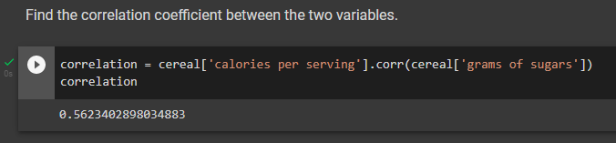
Correlation Coefficient (r)
We can quantify the extent to which two variables are correlated by using a correlation coefficient (r)
The sign (+ or -) indicates the direction of correlation
The numerical quantity indicates the extent of correlation
r can range from -1 to 1
The closer the value is to 0, the weaker the correlation
-1
0
+1
Strong negative
Weak negative
Weak positive
Strong positive
A correlation of 0.56 is considered moderate

Slide 17
Correlation Values
Low Correlation: 0.3 to 0.5
Moderate Correlation: 0.5 to 0.7
Strong Correlation: Greater than 0.7

Slide 18
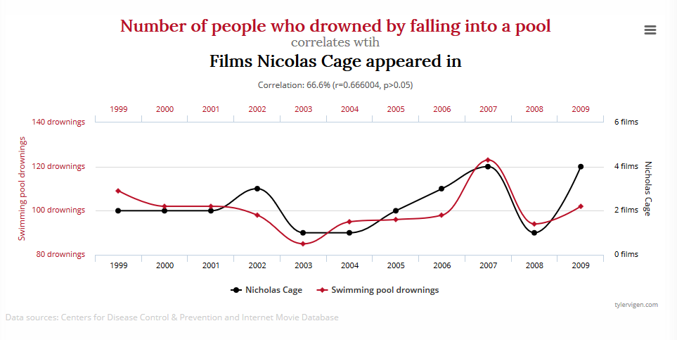
Be careful: correlation != causation
Image source: https://mstranslate.com.au/correlation-vs-causation/

Slide 19
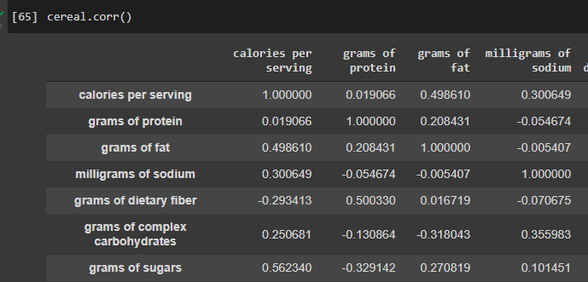
Looking for Correlations
Shows r for every combination of numerical value...this is only a section of the output!

Slide 20
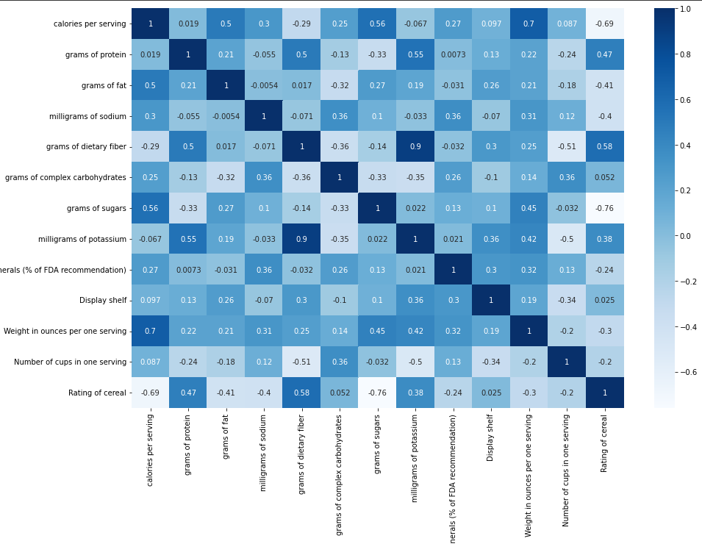
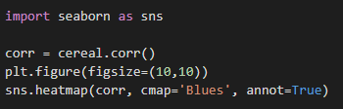
Visualizing correlation with a heat map

Slide 21
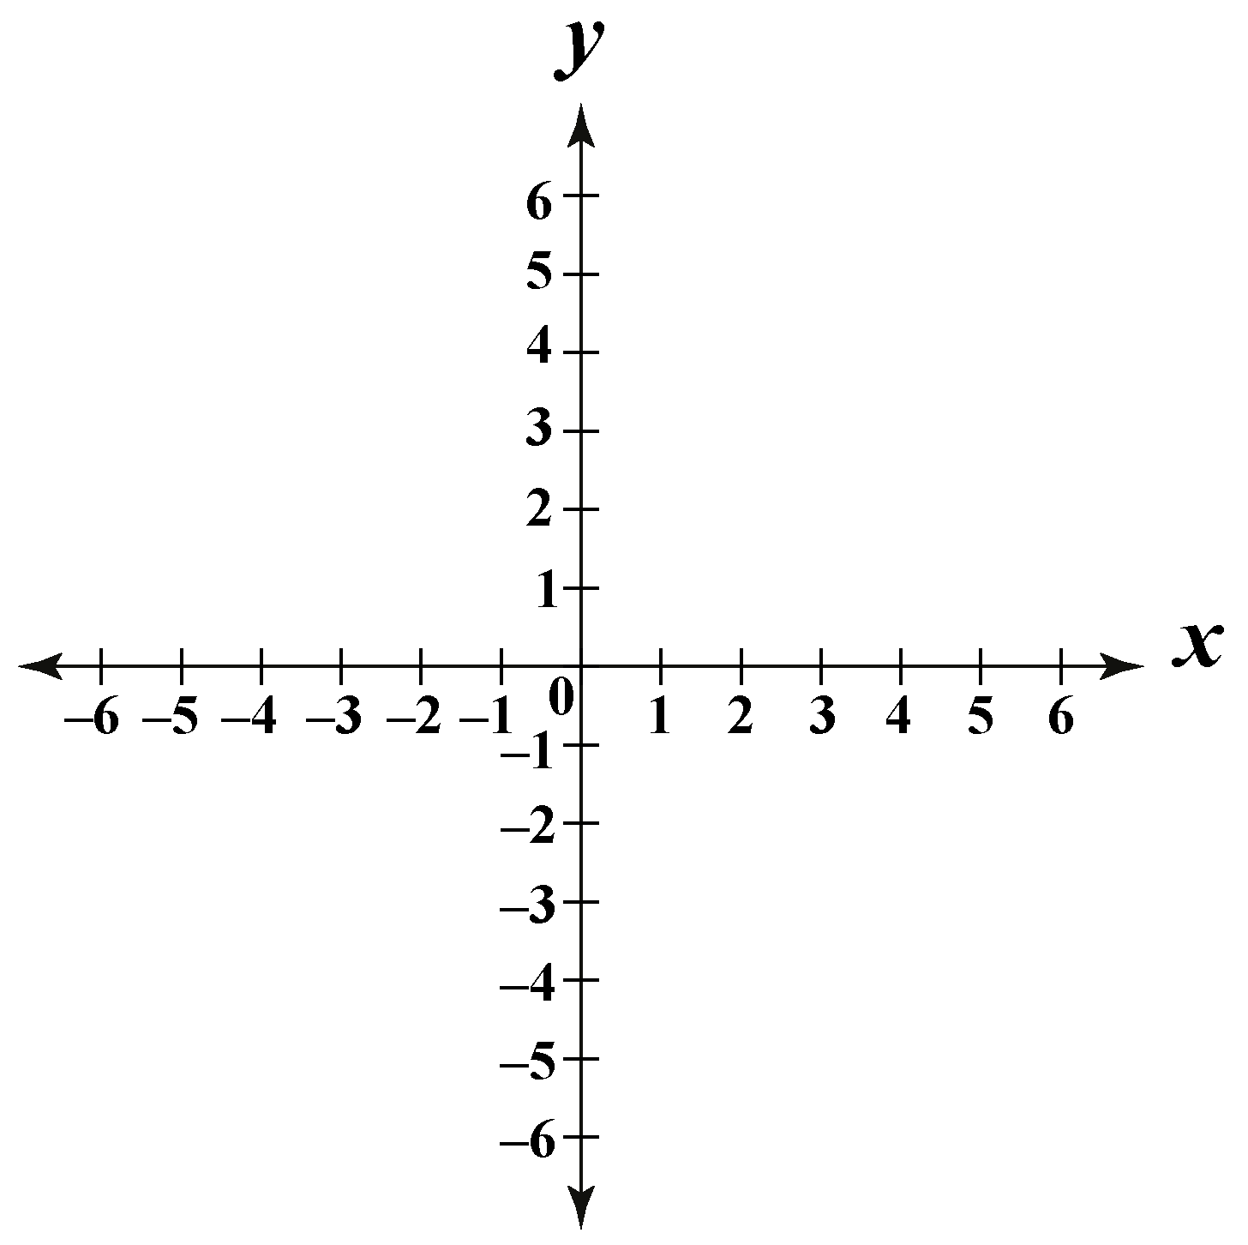
Scatter Plots
(x, y)

Slide 22
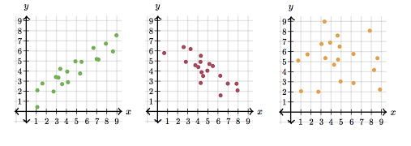
Correlation with Scatter Plots
Positive Correlation
Negative Correlation
No Correlation
Source

Slide 23
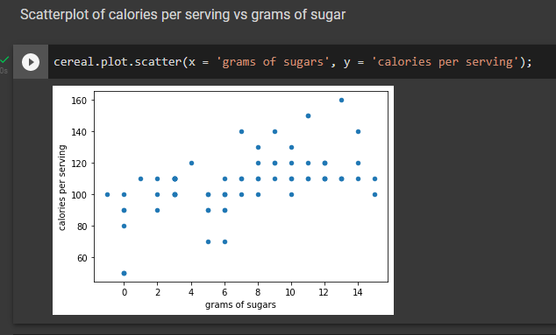
Scatter Plot in Python
This is a positive correlation.
On average, cereals with more sugar also have more calories and cereals with more calories also have more sugar.

Slide 24
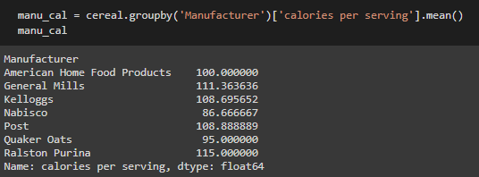
Use Groupby to make bar charts

Slide 25
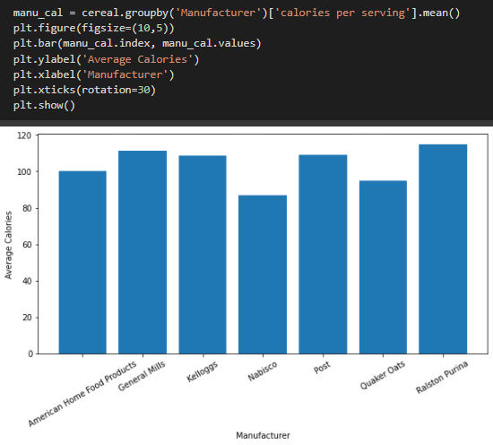
Vertical Bar Chart

Slide 26
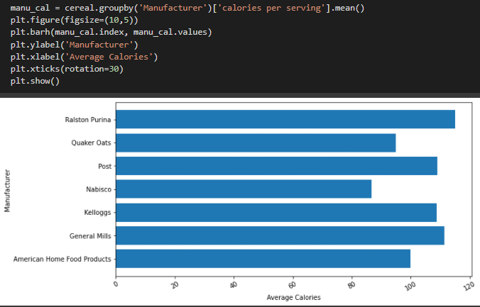
Horizontal bar chart
Notice that plt.barh is used to create a horizontal barchart.
Horizontal bar charts are especially useful when the labels are long

Slide 27
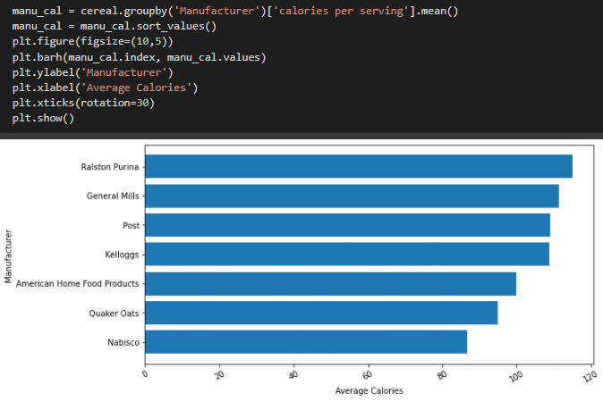
Sorted Vertical Bar Chart

Slide 28
Seaborn
More advanced plots
and trivariate analysis!!
import seaborn as sns

Slide 29
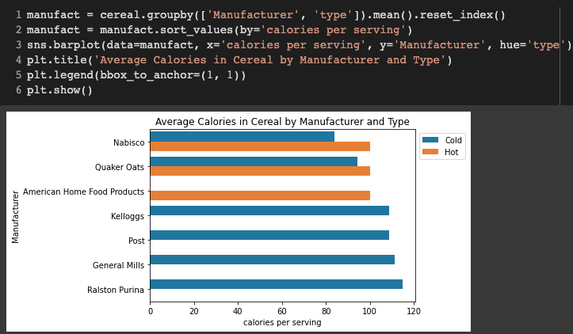
Comparing 3 variables in a barplot:
3rd Variable

Slide 30
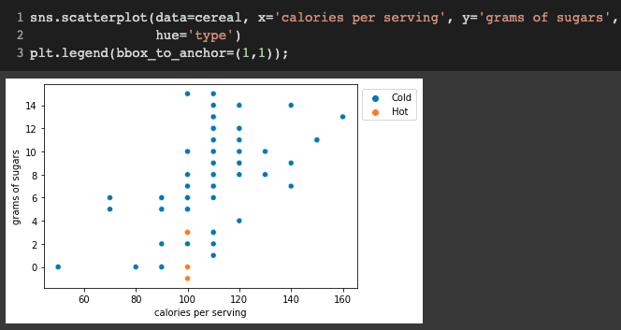
Color Coding Categories in a Scatterplot

Slide 31
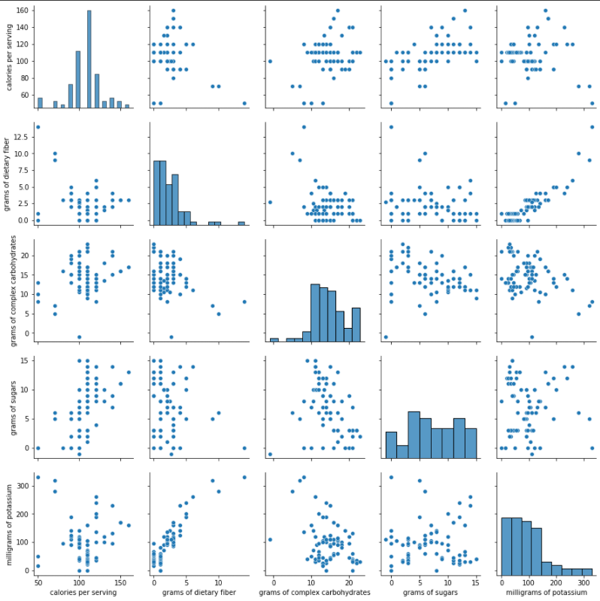

Pair Plot
Distributions
Correlations

Slide 32
Visualization Topics Saved for Next Week
We will be covering Explanatory Visualizations next week (visualizations intended to tell a story for a larger/broader audience)
We are saving most of the visualization aesthetics concepts/questions until then.
Topics saved for next week:
Formatting ticks
Matplotlib styles/seaborn themes
Font customization (titles/axis labels, etc)
Figures with multiple subplots
Multiple subplots with DIFFERENT figure sizes.
Saving/exporting figures (programatically)
Interactive visualizations (if there’s time!)
In the meantime, I am happy to answer any questions about these in office hours after class today.

